Slide 1
DECA Socials
Tips on how to have the most fun with your members!

Slide 2
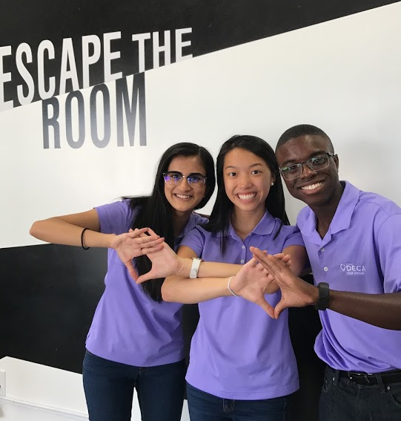
Examples of Activities
Roller Skating
Ice Cream/Pizza
Escape Room
Main Event
Bowling

Slide 3
Organizing a Social
Collectively decide on a place/activity.
Invite the chapter! Give advanced notice and provide details.
Promote the event! Send emails, post on social media, and make flyers using Canva.
Get a rough head-count on who will be attending.

Slide 4
Questions?
If you have any questions, ideas, or requests for further resources please feel free to contact us. We love hearing from you!
Contact a state officer at stateofficers@texasdeca.org for more help and information!

