Slide 2
AN INTRODUCTION TO DECA’S COMPETITIVE EVENTS PROGRAM

Slide 3
INTENDED OUTCOMES
Notes:
At the conclusion of this session, you will be able to:
• Describe DECA’s competitive events’ connection to curriculum.
• Identify categories of DECA’s competitive events.
• Locate and utilize DECA competitive events resources.

Slide 4
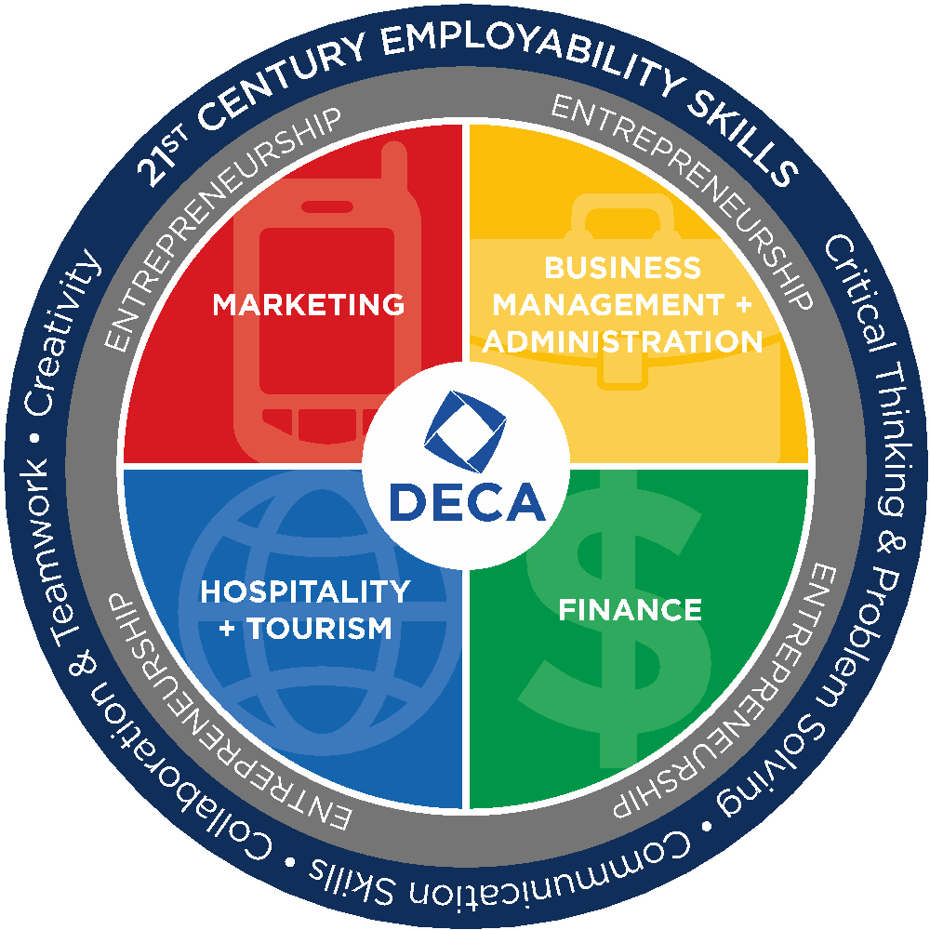
COMPETITIVE EVENTS CONNECTION
National Curriculum Standards
Career Clusters®
21st Century Skills
Notes:
DECA’s Competitive Events Program is based on National Curriculum Standards and the Career Clusters® model. All of DECA’s competitive events also integrate 21st century skills. National Curriculum Standards: The National Curriculum Standards for Business Administration provide insight into what business leaders view as important to the success of employees at various levels and in various specialties.
These standards define the content for the respective Career Cluster®. They inform teachers, administrators, and curriculum developers as to what should be taught. Educators, then, take the standards and determine how to deliver the content (instructional strategies) and how to design the programs and courses.
DECA’s Competitive Events Program also directly aligns with Career Clusters® and National Curriculum Standards. Each role-play and case study are developed using performance indicators which directly link to the knowledge and skill statements that comprise the Career Clusters® and National Curriculum Standards frameworks.
21st Century Skills are a series of skills and abilities that employers seek in their employees. The framework presents a holistic view of 21st century teaching and learning that combines a discrete focus on 21st century student outcomes (a blending of specific skills, content knowledge, expertise and literacies) with innovative support systems to help students master the multi-dimensional abilities required of them in the 21st century.
To succeed in today’s workplace, employees must excel in the 4Cs: 1. Critical thinking and problem solving 2. Communication 3. Collaboration 4. Creativity and innovation
DECA understands that 21st century skills are important to college and career success. DECA members develop 21st century skills through their participation in DECA activities, such as competitive events, educational conferences, corporate partner challenges, educational publications, school-based enterprises and more. Because DECA activities are usually project-based and problem-based, DECA members use high order thinking skills and develop key competencies in the areas of critical thinking and problem solving, communication, collaboration and creativity and innovation.
All DECA competitive events support the development of 21st century skills. For example, role-play events require students to be problem solvers and effective communicators. Written and prepared events require students to collaborate with local businesses and team members, identify and solve complex problems, and then clearly communicate the project to others.
DECA’s Competitive Events Program is a model for assessing 21st century skills and abilities. DECA’s team decision making and individual series events evaluate items, as judged by business professionals, specific to 21st century skills. More Information on 21st Century Skills is available at www.p21.org.

Slide 5
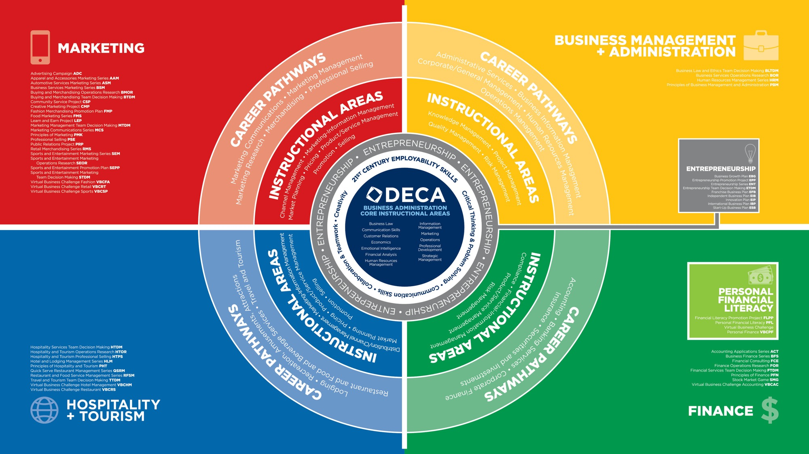
Notes:
This graphic represents the Career Clusters® and National Curriculum Standards model.
Identify the following for the audience:
• The four quadrants represent the four career clusters our events fall into.
• The center of the diagram is the Business Administration Core and these performance indicators are applicable across all of DECA’s events.
• 21st Century skills are the next layer in the center of the diagram. 21st Century Skills are assessed in all of DECA’s competitive events.
• Entrepreneurship is also in the center. Entrepreneurship spans each of the four career clusters.
• Within each Career Cluster instructional areas, career pathways and applicable events are listed.

Slide 6
CATEGORIES OF COMPETITIVE EVENTS
ROLE-PLAY EVENTS
Principles of Business Administration Events
Team Decision Making Events
Individual Series Events
Personal Financial Literacy
ONLINE EVENTS
Stock Market Game
Virtual Business Challenges
WRITTEN AND PREPARED EVENTS
Business Operations Research Events
Entrepreneurship Events
Integrated Marketing Campaign Events
Professional Selling and Consulting Events
Project Management Events
Notes:
DECA’s competitive events can be categorized as one of three different types of events:
• Role-Play Events – These events include a multiple-choice career cluster exam and role-play or case study with a judge.
They are classified by industry and career cluster.
o Principles of Business Administration Events
o Team Decision Making Events
o Individual Series Events
o Personal Financial Literacy
• Written and Prepared Events – Most of DECA’s written events require a written project report submitted and evaluated online, as well as a prepared presentation. The Integrated Marketing Campaign and Professional Selling and Consulting Events also require participants to take a career cluster exam.
o Business Operations Research Events
o Project Management Events
o Entrepreneurship Events
o Integrated Marketing Campaign Events
o Professional Selling and Consulting Events
• Online Events – DECA’s online events challenge members in online business simulations. Using an online program, members compete against other members in their region from their seats in the classroom to earn an opportunity to compete at the international level.
o Stock Market Game
o Virtual Business Challenge
The following slides will cover the different types of events in each category.

Slide 7
PRINCIPLES OF BUSINESS ADMINISTRATION EVENTS
Present Role Play Ideas
Designed for first-year DECA members in an introductory business/marketing course.
Notes:
The Principles of Business Administration Events are designed for first-year DECA members in an introductory business/marketing course.
• 1 Participant
• Business Administration Core Exam
• 1 Role-Play
• 10-minute preparation time
• 10-minute presentation time
• 4 Events
o Principles of Business Management and Administration
o Principles of Finance
o Principles of Hospitality and Tourism
o Principles of Marketing

Slide 8
TEAM DECISION MAKING EVENTS
Based on Event Cluster
Present Role Play Ideas
Designed for teams to analyze a case study.
Notes:
The Team Decision Making Events are designed for teams to analyze a case study.
• 2 Participants
• Cluster Specific Exam
• 1 Case-Study
• 30-minute preparation time
• 15-minute presentation time
• 8 Events
o Business Law and Ethics
o Buying and Merchandising
o Entrepreneurship
o Financial Services
o Hospitality Services
o Marketing Management
o Sports and Entertainment Marketing
o Travel and Tourism

Slide 9
INDIVIDUAL SERIES EVENTS
Based on Event Cluster
Present Role Play Ideas
Designed for members with substantial knowledge/experience in the career area.
Notes:
The Individual Series Events are designed for members with substantial knowledge/experience in the career area.
• 1 Participant
• Cluster Specific Exam
• Role-Play
• 10-minute preparation time
• 10-minute presentation time
• 14 Events
o Accounting Applications
o Apparel and Accessories Marketing
o Automotive Services Marketing
o Business Finance
o Business Services Marketing
o Entrepreneurship
o Food Marketing
o Hotel and Lodging Management
o Human Resources Management
o Marketing Communications
o Quick Serve Restaurant Management
o Restaurant and Food Service Management
o Retail Merchandising
o Sports and Entertainment Marketing

Slide 10
PERSONAL FINANCIAL LITERACY EVENT
Designed to measure the personal finance knowledge and skills and measure the member’s ability to apply decision making to personal financial decisions.
Notes:
The Personal Financial Literacy Event is designed to measure the personal finance knowledge and skills and measure the member’s ability to apply decision making to personal financial decisions.
• 1 Participant
• Financial Literacy Exam
• 1 Role-Play
• 10-minute preparation time
• 10-minute presentation time
• 1 Event
o Personal Financial Literacy

Slide 11
BUSINESS OPERATIONS RESEARCH EVENTS
New topic is provided each year in DECA Guide.
Notes:
The Business Operations Research Events provide an opportunity for participants to demonstrate knowledge and skills needed by management personnel through the preparation of a detailed written strategic plan and presentation based on the results of a research study.
Note: A new topic is provided each year in the DECA Guide.
• 1-3 Participants
• 20 pages allowed
• 15-minute presentation time
• 5 Events
o Business Services Operations
o Buying and Merchandising Operations
o Finance Operations
o Hospitality and Tourism Operations
o Sports and Entertainment Marketing Operations

Slide 12
PROJECT MANAGEMENT EVENTS
Designed as to have members use project management skills to initiate, plan, execute, monitor and control and close a project.
Require members to plan, implement and evaluate a project in your school/community.
Notes:
The Project Management Events are designed as opportunities for participants put their project management skills into action. Participants will actually plan, execute, and evaluate their project within their school/community.
• 1-3 Participants
• 20 pages allowed
• 15-minute presentation time
• 6 Events
o Business Solutions Project
o Career Development Project
o Community Awareness Project
o Community Giving Project
o Financial Literacy Project
o Sales Project

Slide 13
ENTREPRENEURSHIP EVENTS
10 to 20
Designed for members interested in owning/operating their own business.
Provides a continuum from innovation to start-up to growing an existing business.
Notes:
The Entrepreneurship Events are designed for members interested in owning/operating their own business. The Entrepreneurship Events provide a continuum from innovation to start-up to growing an existing business.
• 1-3 Participants
• 10 or 20 pages allowed, depending on event
• 15-minute presentation time
• 6 Events
o Innovation Plan
o Start-Up Business Plan
o Franchise Business Plan
o Independent Business Plan
o Business Growth Plan
o International Business Plan

Slide 14
INTEGRATED MARKETING CAMPAIGN EVENTS
Designed to allow members to develop an integrated marketing campaign of no more than 45 days in length for a real event, product or service and present the campaign in a role-play situation.
Notes:
The Integrated Marketing Campaign Events are designed to allow members to develop an integrated marketing campaign of no more than 45 days in length for a real event, product or service and present the campaign in a role-play situation.
• 1-3 Participants
• Marketing Cluster Exam
• 10 pages allowed
• 15-minute presentation time
• 3 Events
o Integrated Marketing Campaign—Event
o Integrated Marketing Campaign—Product
o Integrated Marketing Campaign—Service

Slide 15
PROFESSIONAL SELLING AND CONSULTING EVENTS
Based on Event
Designed for members to demonstrate their selling or consulting abilities.
New products/services are provided each year in DECA Guide.
Notes:
The Professional Selling and Consulting Events are designed for members to demonstrate their selling or consulting abilities. Note: New products or services are provided each year in the DECA Guide.
• 1 Participant
• Cluster Specific Exam
• 15-minute presentation time
• 3 Events
o Financial Consulting
o Hospitality and Tourism Professional Selling
o Professional Selling

Slide 16
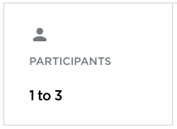
ONLINE EVENTS
STOCK MARKET GAME
VIRTUAL BUSINESS CHALLENGE
Notes:
Stock Market Game
The Stock Market Game is designed for members to develop and manage a virtual investment portfolio of stocks, bonds and mutual funds.
Note: Teams qualify for ICDC through the online simulation in the fall. Teams advancing to ICDC will submit a written entry and prepare a presentation.
• 1-3 Participants
• Online Simulation
• 10 pages allowed (ICDC qualifying teams)
• 15-minute presentation time (ICDC qualifying teams)
Virtual Business Challenge
The Virtual Business Challenges are designed for members to operate a web-based business simulation utilizing a competition version of the Virtual Business software.
Note: Two qualifying rounds are offered; one in the fall and one in the winter.
• 1-3 Participants
• Online Simulation
• Events
o Virtual Business Challenge Accounting
o Virtual Business Challenge Fashion
o Virtual Business Challenge Hotel Management
o Virtual Business Challenge Personal Finance
o Virtual Business Challenge Restaurant
o Virtual Business Challenge Retail
o Virtual Business Challenge Sports

Slide 17
PERFORMANCE INDICATOR LISTS
Notes:
DECA’s performance indicators relate to the National Curriculum Standard Framework.
• The performance indicator lists used by DECA derive from the Business Administration Core and the four career clusters to which DECA is aligned.
• Performance indicator lists are updated annually and are available on https://www.deca.org/high-school-programs/high-school-competitive-events/

Slide 18
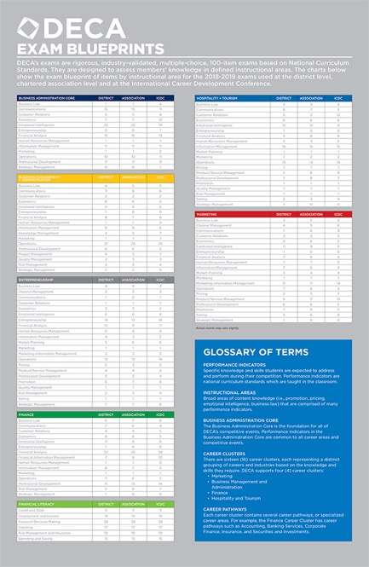
DECA EXAMS
Notes:
DECA uses seven different cluster exams. The exams are designed with test discrimination in mind. Tests are created for the district/regional, state/provincial, and ICDC level conferences. The DECA Exam Blueprint is available each year with a breakdown of number of questions from each instructional area.

Slide 19
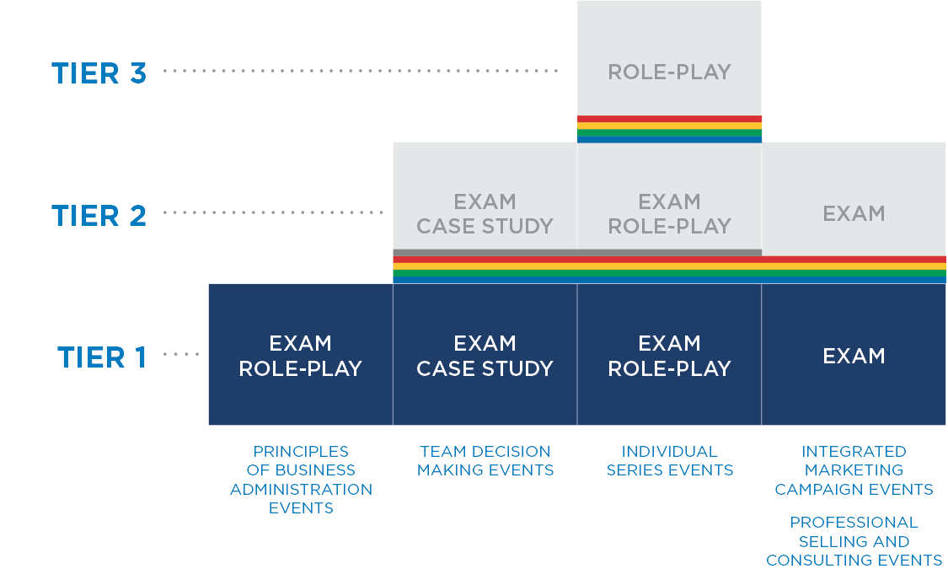
UNDERSTANDING TIERS
Notes:
Tier 1
Business Administration Core Performance Indicators are found in PRINCIPLES OF BUSINESS ADMINISTRATION role-plays and exams, TEAM DECISION MAKING case studies and exams, INDIVIDUAL SERIES role-plays and exams, and INTEGRATED MARKETING CAMPAIGN EVENTS and PROFESSIONAL SELLING AND CONSULTING EVENTS exams.
Tier 2
Career Cluster Performance Indicators are found in TEAM DECISION MAKING case studies and exams, INDIVIDUAL SERIES role-plays and exams, and INTEGRATED MARKETING CAMPAIGN EVENTS and PROFESSIONAL SELLING AND CONSULTING EVENTS exams.
Tier 3
Pathway Performance Indicators are found in INDIVIDUAL SERIES role-play

Slide 20
HOW DO YOU HELP MEMBERS SELECT THE RIGHT EVENT?
Career interests
Job experience
Match strengths to event format
Are they strong test takers?
Are they strong presenters?
Do they prefer as much preparedness as possible?
Do they work well with others?
Notes:
When assisting members in selecting the right event consider the following items:
• Career interests
• Job experience
• Match strengths to event format
o Are they strong test takers?
o Are they strong presenters?
o Do they prefer as much preparedness as possible?
o Do they work well with others?
Participants can find a flow chart to help students identify the events that are “right” on the competitive events poster sent in the chapter packet at the beginning of the school year. This flowchart can also be found at www.deca.org/competitiveevents. DECA+ is a great resource for picking a competitive event. Texas DECA has an interactive tool called ‘choosing the right event’ at www.texasdeca.org/competition-resources

Slide 21
Notes:
Resources are available to help prepare students for competition. The DECA website provides free resources (https://www.deca.org/high-school-programs/high-school-competitive-events/ ) including sample videos, performance indicator lists, sample written events and sample role-plays. Additional resources are available through DECA+.

